Slide 1
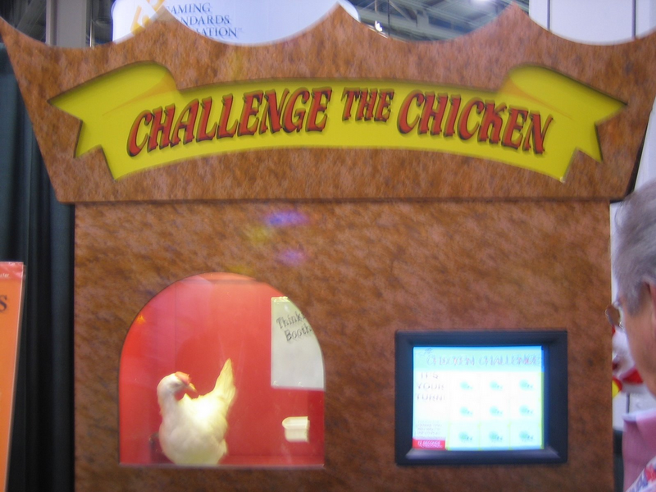

Slide 2
Adversarial Search (game playing search)
We have experience in search where we assume that we are the only intelligent entity and we have explicit control over the “world”.
Let us consider what happens when we relax those assumptions. We have an enemy…

Slide 3
Types of Games
 | Deterministic | Stochastic
Perfect information (fully observable) | Chess, checkers, Go, Tic-Tac-Toe | Backgammon, monopoly
Imperfect information (partially observable) | Battleships | Scrabble, poker, bridge
Games can also be one, two or multi-player (we focus on two player)
Games can be cooperative or competitive (we focus on competitive, or zero-sum, games)

Slide 4
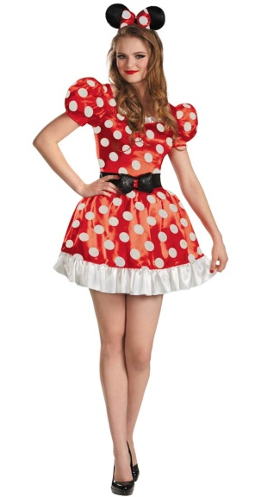
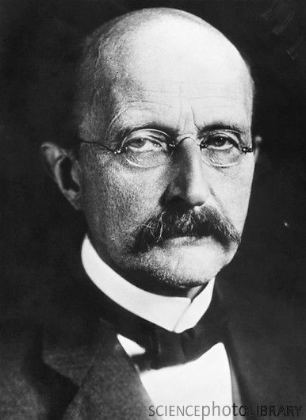
Two Player Games (Deterministic , fully observable)
Max always moves first.
Min is the opponent.
We have
An initial state.
A set of operators.
A terminal test (which tells us when the game is over).
A utility function (evaluation function).
The utility function is like the heuristic function we have seen in the past, except it evaluates a node in terms of how good it is for each player. Positive values indicate states advantageous for Max, negative values indicate states advantageous for Min.
Normally the closer to 1, the better things look for Max, the closer to -1, the better things look for Min.
Max Vs. Min

Slide 5
Two Player Games (Deterministic , fully observable)
Max always moves first.
Min is the opponent.
We have
An initial state.
A set of operators.
A terminal test (which tells us when the game is over).
A utility function (evaluation function).
Sometimes the utility function can double as the terminal test. For example if it returns exactly plus or minus 1.

Slide 6
Adversarial Search Beyond Games
Adversarial search can be applied to economics, business, politics and war!
We will gloss over such considerations here

Slide 7
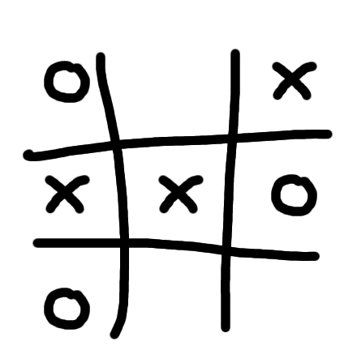
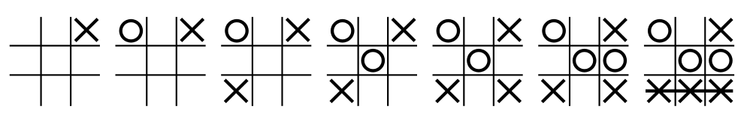
Tic-tac-toe
(noughts and crosses)

Slide 8
Max

Slide 9
Max
Min
...
...
...
...
...
...
...
...
...
Terminal States
Utility
-1
O
1

Slide 10
Max
Min
Max
...
...
...
...
...
...
...
...
...
Terminal States
Utility
-1
O
1

Slide 11
Max
Min
Max
...
...
...
...
...
...
...
...
...
Terminal States
Utility
-1
O
1

Slide 12
A simple abstract game.
Max makes a move, then Min replies.
A1
A2
A3
A11
A12
A13
A21
A22
A23
A31
A32
A33
3
12
8
2
4
6
14
5
2
An action by one player is called a ply, two ply (a action and a counter action) is called a move.

Slide 13
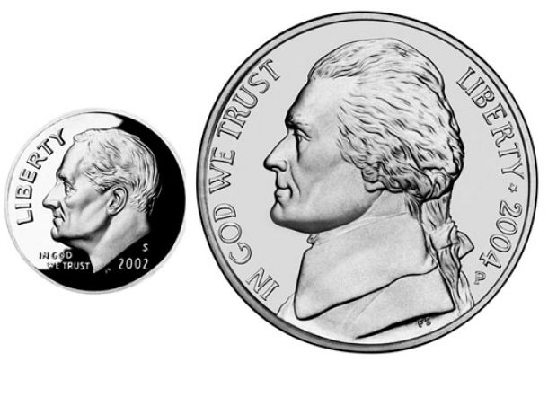
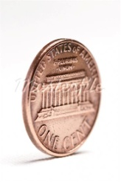
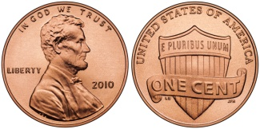
(To help make abstract games more concrete) Imagine a game: Max has a nickel and dime, he must move first, and place any (non-empty) combination of them on the table.
Min has a penny, he replies by putting the penny on the table, either heads up, tails up or on its edge.
Game over! We look up the payoffs in a table.
Payoff Table
N,D, Edge: $3
N,D, Heads: $12
N,D, Tails: $12
N, _, Edge: $2
N, _, Heads: $4
etc
A1
A2
A3
A11
A12
A13
A21
A22
A23
A31
A32
A33
3
12
8
2
4
6
14
5
2

Slide 14
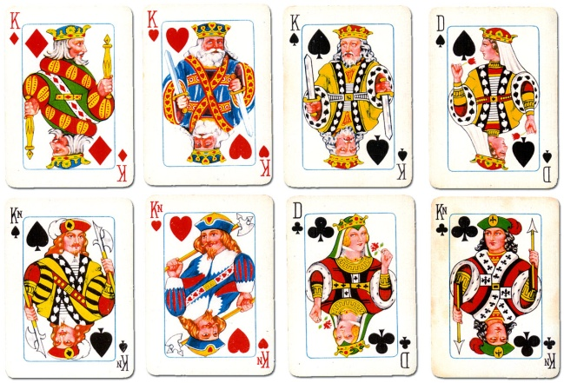
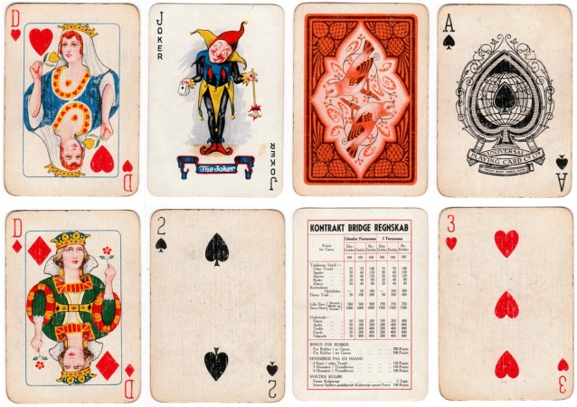
(To help make abstract games more concrete) Imagine a game: Max has 3 Kings,♦,♥,♠, he places one on the table.
Min has the Queen of ♣, he either places it on the table face up, face down, or says “no card!”.
Game over! We look up the payoffs in a table.
Payoff Table
K♦, Q ♣ $3
K♦, Face down $12
K♦, No Card! $8
etc
etc
etc
A1
A2
A3
A11
A12
A13
A21
A22
A23
A31
A32
A33
3
12
8
2
4
6
14
5
2
No Card
No Card
No Card

Slide 15
A simple abstract game.
Max makes a move, then Min replies.
A1
A2
A3
A11
A12
A13
A21
A22
A23
A31
A32
A33
3
12
8
2
4
6
14
5
2
An action by one player is called a ply, two ply (a action and a counter action) is called a move.

Slide 16
The Minimax Algorithm
Generate the game tree down to the terminal nodes.
Apply the utility function to the terminal nodes.
For a S set of sibling nodes, pass up to the parent…
the lowest value in S if the siblings are
the largest value in S if the siblings are
Recursively do the above, until the backed-up values reach the initial state.
The value of the initial state is the minimum score for Max.

Slide 17
3
A1
A2
A3
3
2
2
A11
A12
A13
A21
A22
A23
A31
A32
A33
3
12
8
2
4
6
14
5
2
In this game Max’s best move is A1, because he is guaranteed a score of at least 3 (In fact, he is guaranteed a score of exactly 3, if he plays a rational opponent)

Slide 18
Although the Minimax algorithm is optimal, there is a problem…
The time complexity is O(b^{m}) where b is the effective branching factor and m is the depth of the terminal states.
(Note space complexity is only linear in b and m, because we can do depth first search).
One possible solution is to do depth limited Minimax search.
Search the game tree as deep as you can in the given time.
Evaluate the fringe nodes with the utility function.
Back up the values to the root.
Choose best move, repeat.
We would like to do Minimax on this full game tree...
… but we don’t have time, so we will explore it to some manageable depth.
cutoff

Slide 19
Depth limited Minimax search.
Search the game tree as deep as you can in the given time.
Evaluate the fringe nodes with the utility function.
Back up the values to the root.
Choose best move, repeat.
After reply, search to cutoff, make best move, wait for reply…
Search to cutoff, make best move, wait for reply…
After reply, search to cutoff, make best move, wait for reply…

Slide 20
Example Utility Functions I
Tic Tac Toe
Assume Max is using “X”
e(n) =
if n is win for Max, + ∞
if n is win for Min, - ∞
else
(number of rows, columns and diagonals available to Max) - (number of rows, columns and diagonals available to Min)
X
O
e(n) = 6 - 4 = 2
O
X
X
O
e(n) = 4 - 3 = 1

Slide 21
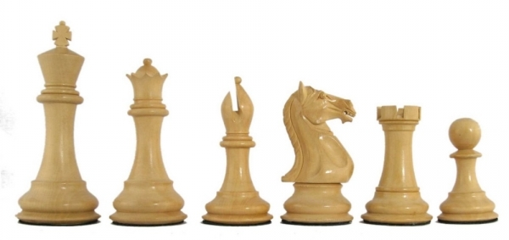
Example Utility Functions II
Chess I
Assume Max is “White”
Assume each piece has the following values
pawn = 1;
knight = 3;
bishop = 3;
rook = 5;
queen = 9;
let w = sum of the value of white pieces
let b = sum of the value of black pieces
e(n) =
w - b
w + b
Note that this value ranges between 1 and -1

Slide 22
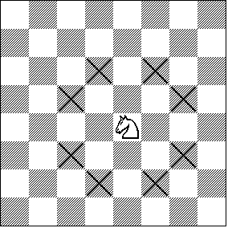
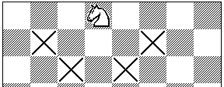
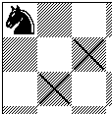
Example Utility Functions III
Chess II
The previous evaluation function naively gave the same weight to a piece regardless of its position on the board...
Let X_{i} be the number of squares the i^{th} piece attacks
e(n) =
piece₁value * X₁ + piece₂value * X₂ + ...
I have not finished the equation. The important thing to realize is that the evaluation function can be a weighted linear function of the pieces value, and its position.

Slide 23
Utility Functions
We have seen that the ability to play a good game is highly dependant on the evaluation functions.
How do we come up with good evaluation functions?
Interview an expert.
Machine Learning.

Slide 24
Take Home Message
We cannot beat Minimax (but see Alpha-Beta below) for exact game playing.
All our time should be spent on better utility functions
Just like
We cannot beat A*, all our time should be spend on better heuristic functions

Slide 25
Alpha-Beta Pruning I
We have seen how to use Minimax search to play an optional game.
We have seen that because of time limitations we may have to use a cutoff depth to make the search tractable. Using a cutoff causes problems because of the “horizon” effect.
Is there some way we can search deeper in the same amount of time?
Yes! Use Alpha-Beta Pruning...
Game winning move.
Best move before cutoff...
… but all its children are losing moves

Slide 26
Alpha-Beta Pruning II
If you have an idea that is surely bad, don't take the time to see how truly awful it is.
Pat Winston
3
A1
A2
A3
3
≤ 2
2
A11
A12
A13
A21
A22
A23
A31
A32
A33
3
12
8
2
14
5
2
Stops completely evaluating a move when at least one possibility has been found that proves the move to be worse than a previously examined move.

Slide 27
Alpha-Beta Pruning III
Effectiveness of Alpha-Beta
Alpha-Beta is guaranteed to compute the same Minimax value for the root node as computed by Minimax
In the worst case Alpha-Beta does NO pruning, examining b^{d} leaf nodes, where each node has b children and a d-ply search is performed
In the best case, Alpha-Beta will examine only 2b^{d/2} leaf nodes. Hence if you hold fixed the number of leaf nodes then you can search twice as deep as Minimax!
The best case occurs when each player's best move is the leftmost alternative (i.e., the first child generated). So, at MAX nodes the child with the largest value is generated first, and at MIN nodes the child with the smallest value is generated first. This suggest that we should order the operators carefully...
In the chess program Deep Blue, they found empirically that Alpha-Beta pruning meant that the average branching factor at each node was about 6 instead of about 35-40

Slide 28
Here is a trivial, but legal example.
Max makes a move, and the game is immediately over!
What should Max do?
A
B (5)
C (100)
D (-7)

Slide 29
Max should move to C, and win 100 dollars
A
100
B (5)
C (100)
D (-7)

Slide 30
A more interesting game
Max has three choices, and depending on what he does, Min has 2 or 3 choices of a reply
What should Max do?
A
B
C
D
E (4)
F (5)
G(6)
H (2)
J (45)
K (3)
L (8)
Let us use Alpha-Beta pruning to find out.

Slide 31
First we explore the subtree under B
If we moved there, Min could give us 4 dollars, or 5 dollars
If we assume that Min in rational, the expected payoff is 4 dollars
A
4
B
C
D
E (4)
F (5)
G(6)
H (2)
J (45)
K (3)
L (8)
Note that some people would write here <=4 dollars.
That is to say, they would label subtree B as four dollars or greater
If Max is rational, that is unnecessary

Slide 32
Now we begin to explore the subtree under C, beginning with G
If we moved to C, and Min moved us to G, we would get 6 dollars, which is better than 4
This looks promising, so we keep exploring, visiting H
If we moved to C, and Min moved us to H, we would get 2 dollars, which is worse than 4
A
4
<=2
B
C
D
E (4)
F (5)
G(6)
H (2)
J (45)
K (3)
L (8)
Given this, we don’t care what is in J, we can prune it
We push less than or equal to 2 up the subtree to label node C

Slide 33
Finally we begin to explore the subtree under D, beginning with K
If we moved to D, and Min moved us to K, we would get 3 dollars, which is worst than 4
Given that, we don’t care what is in L, we can prune it.
A
4
<=2
<=3
B
C
D
E (4)
F (5)
G(6)
H (2)
J (45)
K (3)
L (8)
Given this, we don’t care what is in J, we can prune it
We push less than or equal to 3 up the subtree to label node D

Slide 34
So Max’s best move is to B, and he expects to win 4 dollars
A
4
4
<=2
<=3
B
C
D
E (4)
F (5)
G(6)
H (2)
J (45)
K (3)
L (8)

Slide 35
Here is more complex game tree, the depth and branching factors depend on how we play
As before, we will start exploring subtree B..
A
B
C
D
H
J
E (4)
F (99)
G(6)
K (3)
L (8)
M (3)
N (4)
O (7)
P (9)

Slide 36
Playing B guarantees me 4 dollars
If Max pays C and Min tried G, that would be a 6 dollar payoff, better than 4, so we must keep exploring the C subtree…
A
4
B
C
D
H
J
E (4)
F (99)
G(6)
K (3)
L (8)
M (3)
N (4)
O (7)
P (9)

Slide 37
If Max pays C and Min tried H, then there are two choices for Max
The first is M, it only pays 3 dollars
But suppose that N paid 10000 dollars! (actually, anything better than 4 would do)
We need to find out, so we go to N, and find 4
A
4
B
C
D
H
J
4
E (4)
F (99)
G(6)
K (3)
L (8)
M (3)
N (4)
O (7)
P (9)

Slide 38
…we need to find out, so we go to N, and find 4
At this, I can prune the J subtree. It does not help me to know what the values there are
A
4
B
<=4
C
D
H
J
4
E (4)
F (99)
G(6)
K (3)
L (8)
M (3)
N (4)
O (7)
P (9)

Slide 39
Finally , we need to visit the D subtree
As soon as we explore K and find its value is 3 we can prune the rest of the subtree
A
4
B
<=4
<=3
C
D
H
J
4
E (4)
F (99)
G(6)
K (3)
L (8)
M (3)
N (4)
O (7)
P (9)

Slide 40
Thus Max’s best move is to pay B, and he expects to win 4 dollars
A
4
4
B
<=4
<=3
C
D
H
J
4
E (4)
F (99)
G(6)
K (3)
L (8)
M (3)
N (4)
O (7)
P (9)

Slide 41
Use Minimax or Alpha-Beta, but don’t search so deep…
4-ply ≈ human novice
8-ply ≈ typical PC, human master
12-ply ≈ Deep Blue, Kasparov
Grandmaster
Master
Beginner

Slide 42
Solved Games
A solved game is a game whose outcome (win, lose, or draw) can be correctly predicted from any position, given that both players play perfectly. Games which have not been solved are said to be "unsolved".
The most obvious way to solve a game, is to run the Minimax Algorithm all the way to the leaf nodes, and back up the scores to the root node. At that point, there are only three options:
It is a win for first player.
It is a win for second player.
It is a draw.
It is rare we can actually do this full search to the leaf nodes.

Slide 43
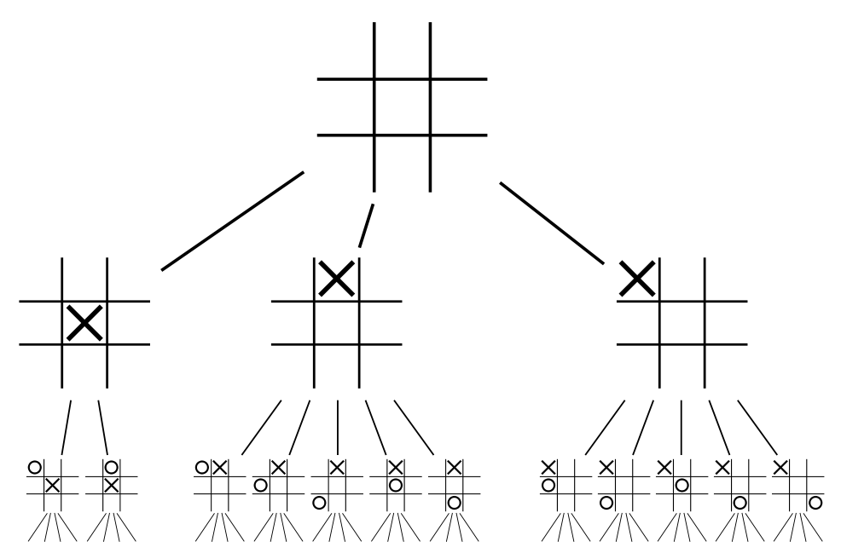
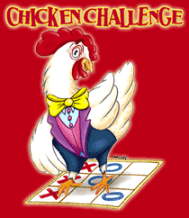
The backed up utility function (evaluation function) for Tic-tac-toe is zero. In other words, a draw.
To put it another way, if god A played this game with god B a trillion times, the outcome would always be a draw.
0
Thus we say, Tic-tac-toe is solved
A solved game is a game whose outcome (win, lose, or draw) can be correctly predicted from any position, given that both players play perfectly.

Slide 44
Remember our toy example?
It is solved. It is a win for Max (a win of 3)
3
A1
A2
A3
3
2
2
A11
A12
A13
A21
A22
A23
A31
A32
A33
3
12
8
2
4
6
14
5
2

Slide 45
Here is a different toy example
It is solved. It is a loss for Max (a loss of 1 for Max, or a win for Min of 1)
-1
A1
A2
A3
-1
-44
-9
A11
A12
A13
A21
A22
A23
A31
A32
A33
-1
12
8
2
-44
6
0
-9
10,000

Slide 46
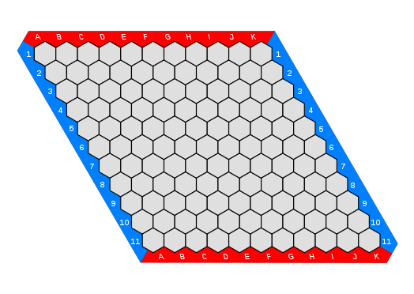
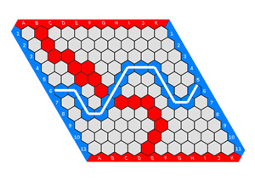

Hex is solved
Hex is a win (for Max)
One way to solve a game is to build the entire search tree and run Minimax on it.
However sometimes that is not necessary…

Slide 47
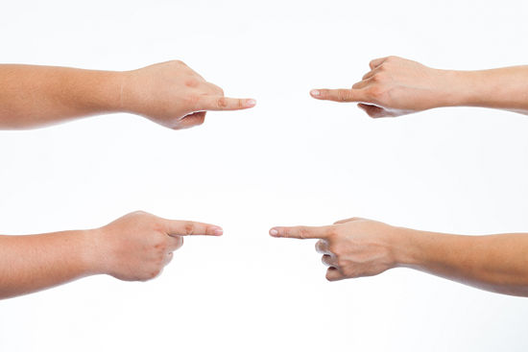
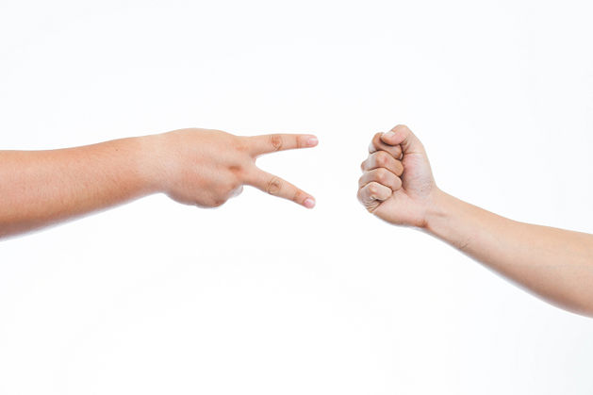
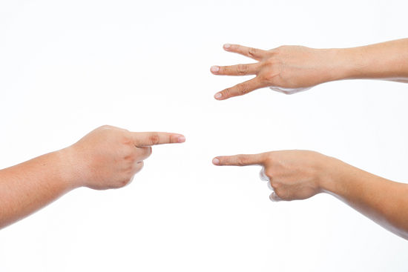
Chopsticks is Solved
(Swords, Sticks, Split, Cherries and Bananas)
Chopsticks is a loss (for Max)
Players extend a number of fingers from each hand and transfer those scores by taking turns to tap one hand against another.

Slide 48
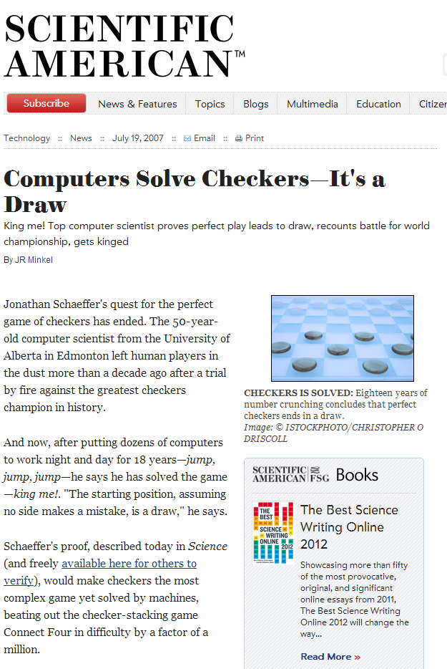
Checkers is Solved!
Checkers is a draw
The game of checkers has roughly 500 billion billion possible positions (5 × 10²⁰). The task of solving the game, determining the final result in a game with no mistakes made by either player, is daunting. From 1989 to 2007, almost continuously, dozens of computers have been working on solving checkers, applying state-of-the-art artificial intelligence techniques to the proving process.

Slide 49
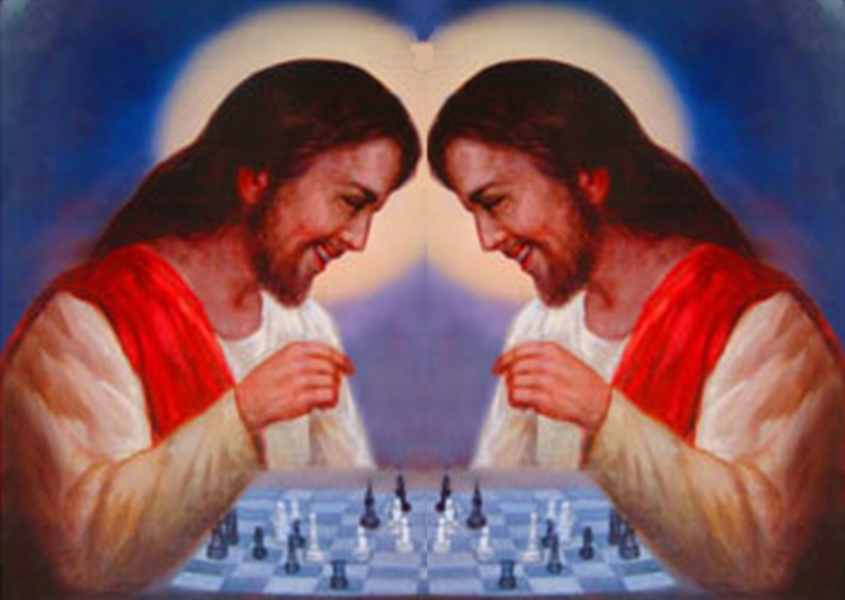
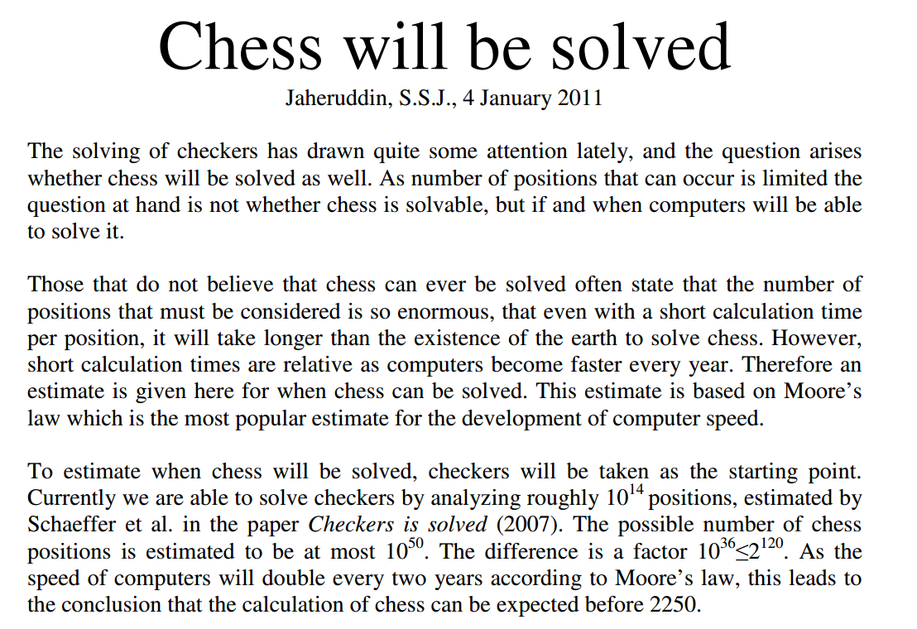
Chess is not Solved I
Will chess ever be solved?
One estimate is that it will be solved in 2250 (about 200 years) assuming Moore’s law holds all that time!!

Slide 50
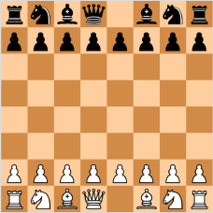
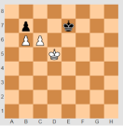
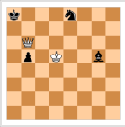
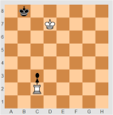
Chess is not Solved II
However, every endgame, with 7 pieces or fewer has been solved!
This does not help that much, since most games are over long before we get down to 7 pieces.
All 4-piece endgames were solved in the late 80s
In the early 90s, all 5-piece endgames were solved
In 2005, all 6-piece endings were solved.
In 2012, all 7-piece endings were solved.
The computer memory required for all 7-piece endings is 140 terabytes.

Slide 51
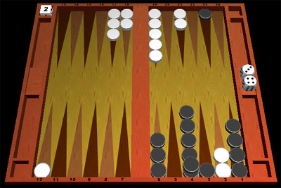
Games With Chance
Consider backgammon
A die roll determines the moves a player can make
Alternates moves and die rolls
Representation
Add chance nodes to the game tree

Slide 52
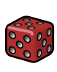


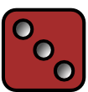
Chance Nodes
Note that different games can be:
Chance, Max, Min, Chance, Max, Min,..
Max, Chance, Min, Chance, Max, Chance, Min,..
Max, Min, Chance, Max, Min, Chance,..
Max
Chance
1/6
1
1/6
2
1/6
3
…
…
P(s) = Probability of roll
Value of roll

Slide 53

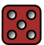

Chance Nodes
Note that different games can be:
Chance, Max, Min, Chance, Max, Min,..
Max, Chance, Min, Chance, Max, Chance, Min,..
Max, Min, Chance, Max, Min, Chance,..
Max
Chance
1/6
1
1/6
2
1/6
3
…
…
P(s) = Probability of roll
Min
Value of roll
…
…
Chance
…
…
…
…
…
…
(The interleaving depends on the game)

Slide 54
Expectminimax Value
Extend minimax idea to chance nodes
Expectiminimax value
P(s) is the probability of a random event (e.g., die roll) occurring
Time complexity
O(b^{m}n^{m}), where n is the number of distinct events
α-β pruning can be extended, but still enormous time complexity

Slide 55
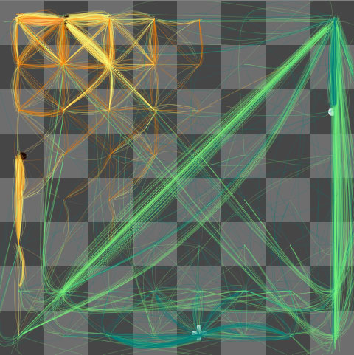
Very nice visualization of Chess Search
The machine's thoughts, endgame The machine foresees that white's pawn will become a queen, and dominate the board as the black king flees.
www.turbulence.org/spotlight/thinking/chess.html

Slide 56
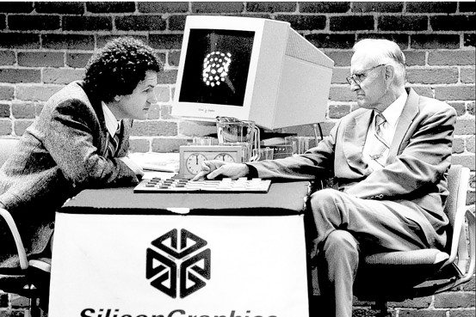
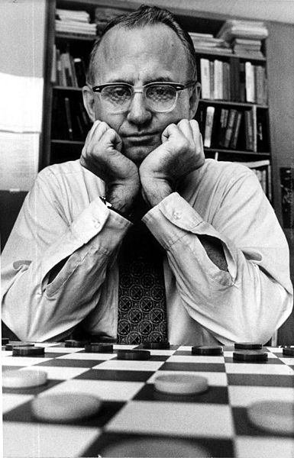
Checkers: Tinsley vs. Chinook
The average branching factor for checkers is about 10. The effective tree depth is about 40
Chinook is the first computer program to win the world champion title in a competition against humans. Chinook was declared the Man-Machine World Champion in checkers in 1994
Tinsley suffered loss to Chinook
Marion Tinsley (1927 – 1995) is considered the greatest checkers player who ever lived. He was world champion from 1955–1958 and 1975–1991. Tinsley never lost a World Championship match, and lost only five games (to humans) in his entire 45 year career.

Slide 57
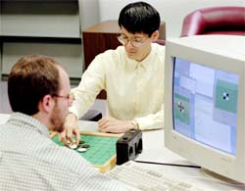
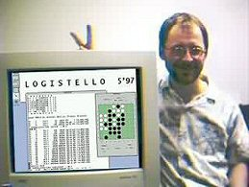
Othello: Murakami vs. Logistello
1997: The Logistello software crushed Murakami by 6 games to 0
The average branching factor for Othello is about 7. The effective tree depth is 60, assuming that the majority of games end when the board is full.
Logistello software written by Michael Buro
Takeshi Murakami: World (Human) Othello Champion

Slide 58
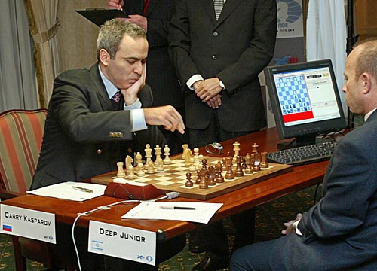
Chess: Kasparov vs. Deep Blue
1997: IBM Deep Blue wins by 3 wins, 1 loss, and 2 draws
The average branching factor for chess is about 36. The effective tree depth is about 40

Slide 59
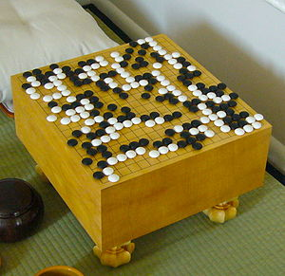
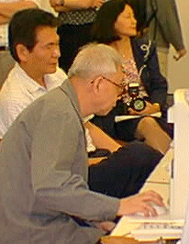
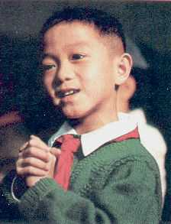
Go: Goemate vs. ??
Chen Zhixing
Author of Goemate (arguably the best Go program available today)
As we shall see, this slide is out of date
Gave Goemate a 9 stone
handicap and still easily
beat the program,
thereby winning $15,000

Slide 60
Adversarial Search: Revisted (game playing search)
We have experience in search where we assume that we are the only intelligent entity and we have explicit control over the “world”.
Let us consider what happens when we relax those assumptions.

Slide 61
Example Utility Functions II
Chess I
Assume Max is “White”
Assume each piece has the following values
pawn = 1;
knight = 3;
bishop = 3;
rook = 5;
queen = 9;
let w = sum of the value of white pieces
let b = sum of the value of black pieces
e(n) =
w - b
w + b
Note that this value ranges between 1 and -1

Slide 62
Depth limited Minimax search.
Search the game tree as deep as you can in the given time.
Evaluate the fringe nodes with the utility function.
Back up the values to the root.
Choose best move, repeat.
After reply, search to cutoff, make best move, wait for reply…
Search to cutoff, make best move, wait for reply…
After reply, search to cutoff, make best move, wait for reply…

Slide 63
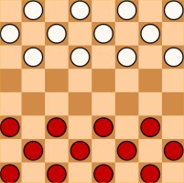
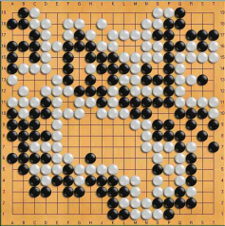
Branching Factor
Average game length
Game-tree complexity
The Game-tree complexity of Go is about 2⁷⁸⁷ times that of Chess. So even if Moore's law holds out forever, it would take about 700 years for Alpha-Beta to be competitive here.
Checkers
Chess
Go
8
35
250
70
123
150
10³¹
10¹²³
10³⁶⁰

Slide 64
Super Human Performance
“Although progress has been steady, it will take many decades of research and development before world-championship– caliber go programs exist”. Jonathan Schaeffer, 2001
Checkers
Chess
Go
“It may be a hundred years before a computer beats humans at Go—maybe even longer.”
Dr. Piet Hut, 1997
1994
1997
?

Slide 65
Some Concrete Numbers
Exhaustively calculating the first eight moves would require computing 512 quintillion (5.12×10²⁰) possible combinations. As of March 2014, the most powerful supercomputer in the world, NUDT's "Tianhe-2", can sustain 33 petaflops. At that rate, even given an exceedingly low estimate of 10 operations required to assess the value of one play of a stone, Tianhe-2 would require 4 hours to assess all possible combinations of the next eight moves in order to make a single play.
Go
?
8

Slide 66
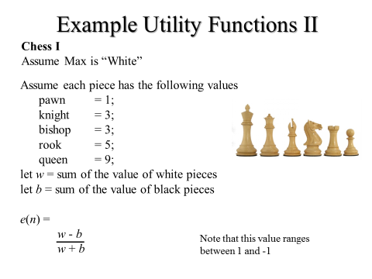
We have good utility functions for Checkers, Chess etc. What about Go?
All utility functions tend to work better, the deeper you are in the tree.
Even if we could get a supercomputer, and we could wait four hours, we would find that the utility function is basically the same for all nodes on the horizon! So we have no information to make an informed choice.
8

Slide 67
Monte Carlo Tree Search Intuition
Imagine the following:
We are playing Go, and we need to choose between two moves, one is the move that is to the root of the red subtree, the other is the move that is to the root of the blue subtree.
The best evaluation function basically says “I have no idea which is better, maybe flip a coin?”
It happens to be true (but we have no way to know this) that:
90% of the terminal nodes in Red are wins for white (Max)
50% of the terminal nodes in Blue are wins for white (Max)
So, all things being equal, Red is a much better choice.
Red
Blue

Slide 68
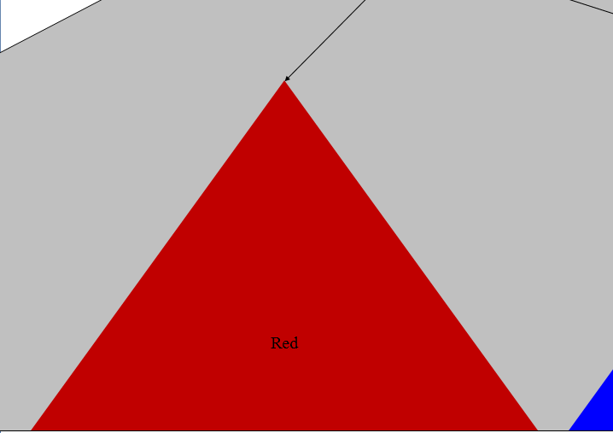
Suppose we started at the root of Red, and randomly traversed down the tree to a terminal node. What is the probability that this terminal node is a win for white (Max)?
It is 0.9
If I did the same for the Blue subtree, what is the probability that this terminal node is a win for white (Max)?
It is 0.5

Slide 69
Suppose I do this multiple times, lets say ten times, what is the expected number of wins for White (Max)?

Slide 71
Think of as: 9/10 = 90%
So 90% of the games that pass through this node are wins for Max
Likewise 6/10 = 60%
So 60% of the games that pass through this node are wins for Max
9/10
6/10
Red
Blue
Note that the correct value is 50%, but our estimate of 60% is pretty close

Slide 72
Monte-Carlo tree search (MCTS)
Until we run our of time (lets say one minute) MCTS repeats four phases:
descent, roll-out, update, and growth.
descent phase: expand current node
roll-out phase: play n random games from each leaf node (in my example, n = 3)
update phase: the statistics (number of wins) are passed up the tree.
growth phase: expand the most promising node.

Slide 73
descent phase

Slide 74
roll-out phase
Random Game 1: Win for white

Slide 75
roll-out phase
Random Game 2: Win for black
Random Game 1: Win for white

Slide 76
roll-out phase
Think of as: 2/3 =66.6%
So 66.6% of the games that pass through this node are wins for Max
2/3
Random Game 2: Win for black
Random Game 1: Win for white
Random Game 3: Win for white

Slide 77
roll-out phase
2/3
3/3
Random Game 3: Win for white
Random Game 1: Win for white
Random Game 2: Win for white

Slide 78
update phase
We can update the ancestor node(s)
So 7/12 of the games that pass through the root are wins for Max
7/12
2/3
3/3
1/3
1/3

Slide 79
growth phase
7/12
2/3
3/3
1/3
1/3

Slide 80
roll-out phase
7/12
2/3
3/3
1/3
1/3
1/3

Slide 81
update phase
8/15
2/3
4/6
1/3
1/3
1/3

Slide 82
growth phase
8/15
2/3
4/6
1/3
1/3
1/3

Slide 83
roll-out phase
8/15
2/3
4/6
1/3
1/3
3/3
1/3

Slide 84
update phase
11/18
5/6
4/6
1/3
1/3
3/3
1/3

Slide 85
11/18
5/6
4/6
1/3
1/3
3/3
1/3
Stop! We ran out of time, our one minute is up. Of our four options, one has a the highest estimated probability of a win (5/6), so that is our move.

Slide 86
11/18
5/6
4/6
1/3
1/3
1/3
We wait a minute for Min to make his move. He choses the bold circle.
This now becomes the root of our new search tree, and we begin our one minute of MCTS again….

Slide 87
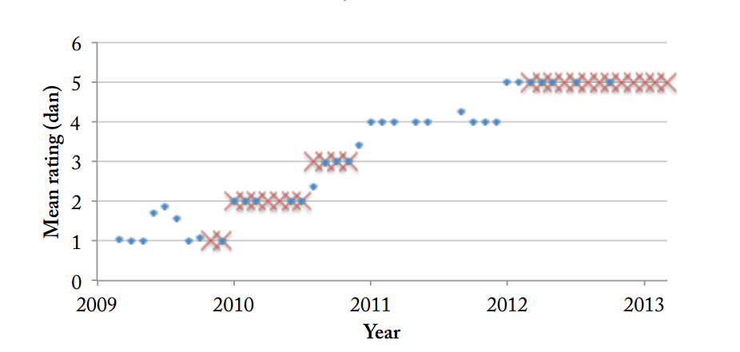
When will AI Go be superhuman?
I found this chart of progress in 2013, so it extrapolated it (next slide)….
Zen19 ratings over time on KGS Go servers. Data from KGS (2010, 2013a).
Adapted from: Algorithmic Progress in Six Domains. Katja Grace
There are about 100 USA players at 5 dan or above

Slide 88
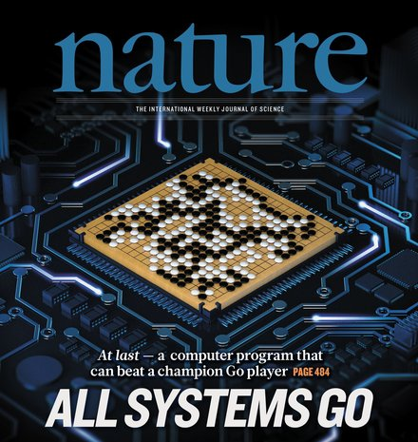

When will AI Go be superhuman?
It predicted human equivalence around 2017
9
Best Humans
2014
2015
2016
2017
In the 2017 Future of Go Summit, AlphaGo beat Ke Jie, the world No.1 ranked player at the time, in a three-game match.

